Slide 1


Slide 2
General Auditor:Diaa Ezzat Hmadan
Abdullah Muhammed Abdul Hamid
Shady Ahmed Muhammad
Safia Yusuf Abdelghany
Nada Muhammad Ahmed
Wafaa Atef Ahmed
Abdul Rahman Al- Sayed Ahmed
01
Smart
Solutions
ODOO RETAIL MANAGEMENT SYSTEM
STREAMLINING RETAIL OPERATIONS WITH ODOO

Slide 3
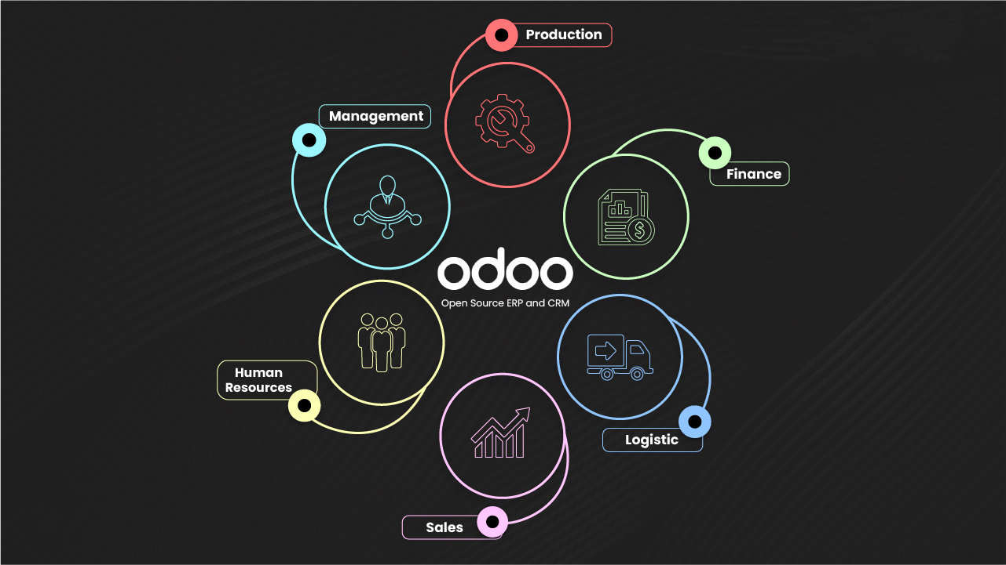

02
Introduction
TO ODOO
What is Odoo?
Odoo is a suite of open-source business apps.
Offers tools for ERP, CRM, inventory, POS,and more.
Tailored for businesses of all sizes.
Scalable and modular structure.

Slide 4
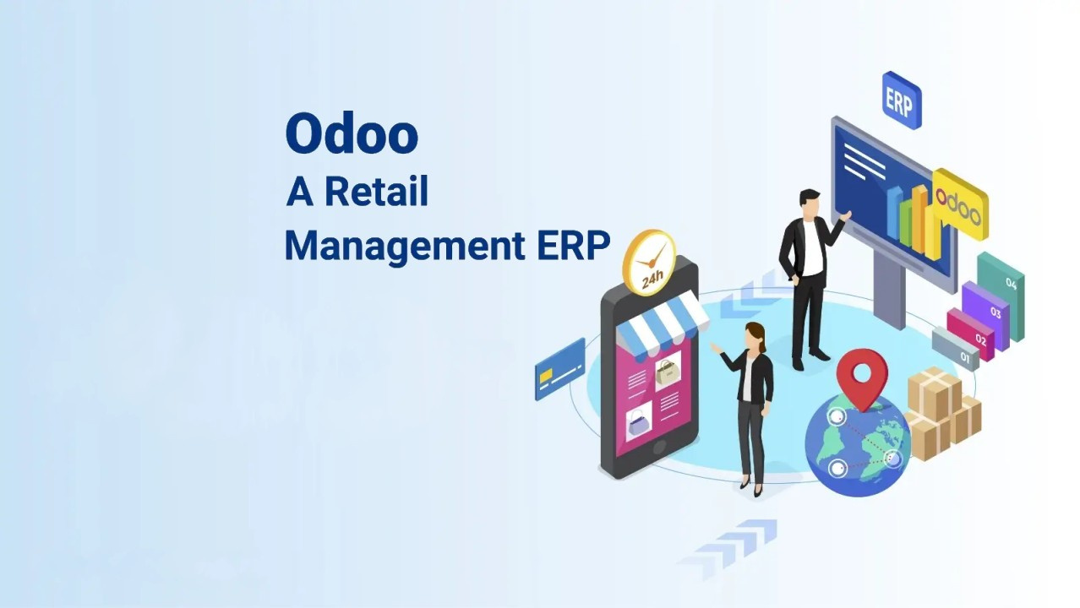
03
Key Business
Overview of Odoo Retail Management System
Odoo is an all-in-one business software solution that includes a robust Retail Management System. It is particularly known for its flexibility, scalability, and integration capabilities, making it a great choice for businesses looking to manage various operations from a single platform
Point of Sale (POS)
Inventory & Product Management
Purchasing and Supplier Management
Customer Relationship Management (CRM)
Accounting and Invoicing
Reporting and Analytics
Employee Management
Multi-Store Management
E-commerce Integration

Slide 5
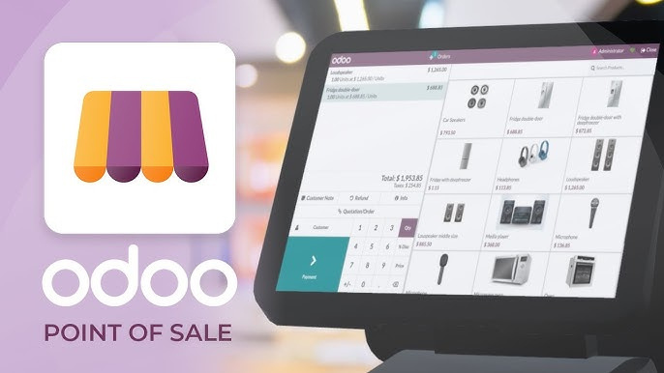
04
POINT OF SALE
(POS)
Odoo POS is fully integrated with other Odoo apps like Inventory and Sales.
Supports real-time syncing between physical stores and online platforms.
Works both online and offline, enabling retailers to continue operations without internet access.
Accepts multiple payment methods (cash, cards, mobile payments).
Offers customer data and loyalty program integration.

Slide 6
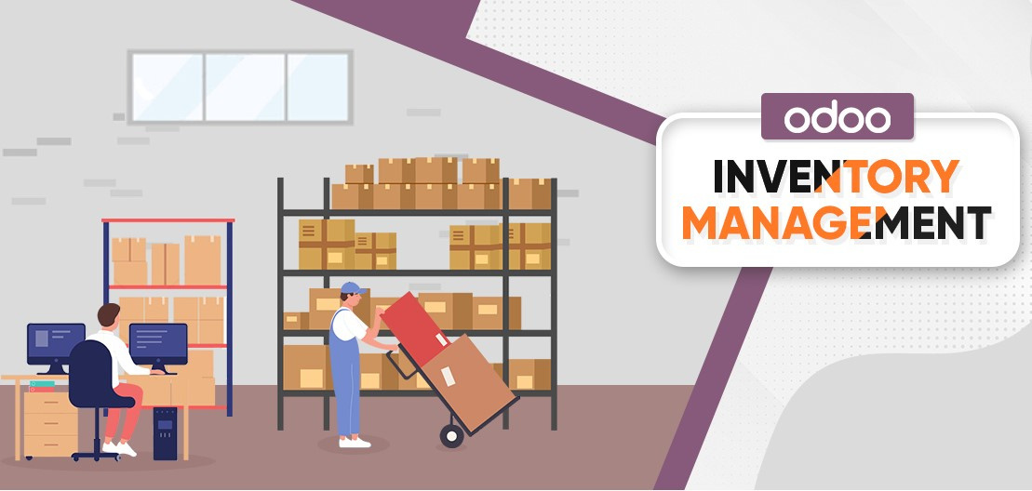
INVENTORY & PURCHASING
05
& PRODUCT MANAGEMENT
Inventory Management
Odoo automates inventory replenishment, keeps track of stock levels in real-time, and integrates with suppliers for purchasing.
Advanced tracking of products via lot numbers or serial numbers.
Multi-warehouse management, enabling retailers to oversee stock across multiple locations.
Real-time updates for online and offline stock synchronization, reducing overselling issues.
Purchasing and Supplier Management
Odoo helps manage supplier relationships by automating purchasing, creating RFQs (Request for Quotation), and tracking purchase orders.
Keeps track of vendor performance, ensuring the best deals and timely deliveries.
Product Management
Helps in managing product catalogs, SKUs, variants (e.g., size, color), and categories efficiently.
Integrated with barcode scanning to streamline product identification and inventory updates.
Supports bundling and kitting of products, ideal for promotions and seasonal offerings.

Slide 7
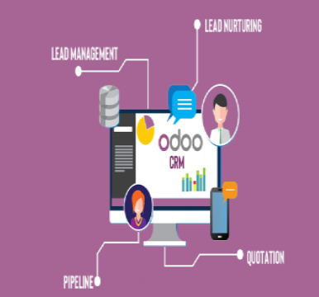

Customer Relationship Management
06
(CRM)
Collects customer data (e.g., contact info, purchase history) to support personalized service and targeted marketing.
Tracks customer interactions and manages loyalty programs, providing rewards and discounts for repeat customers.
Facilitates customer support and after-sales service.

Slide 8


07
EMPLOYEE MANAGEMENT
Manages employee shifts, roles, and permissions within the POS system.
Tracks individual sales performance and productivity.
Facilitates commission-based pay structures.

Slide 9
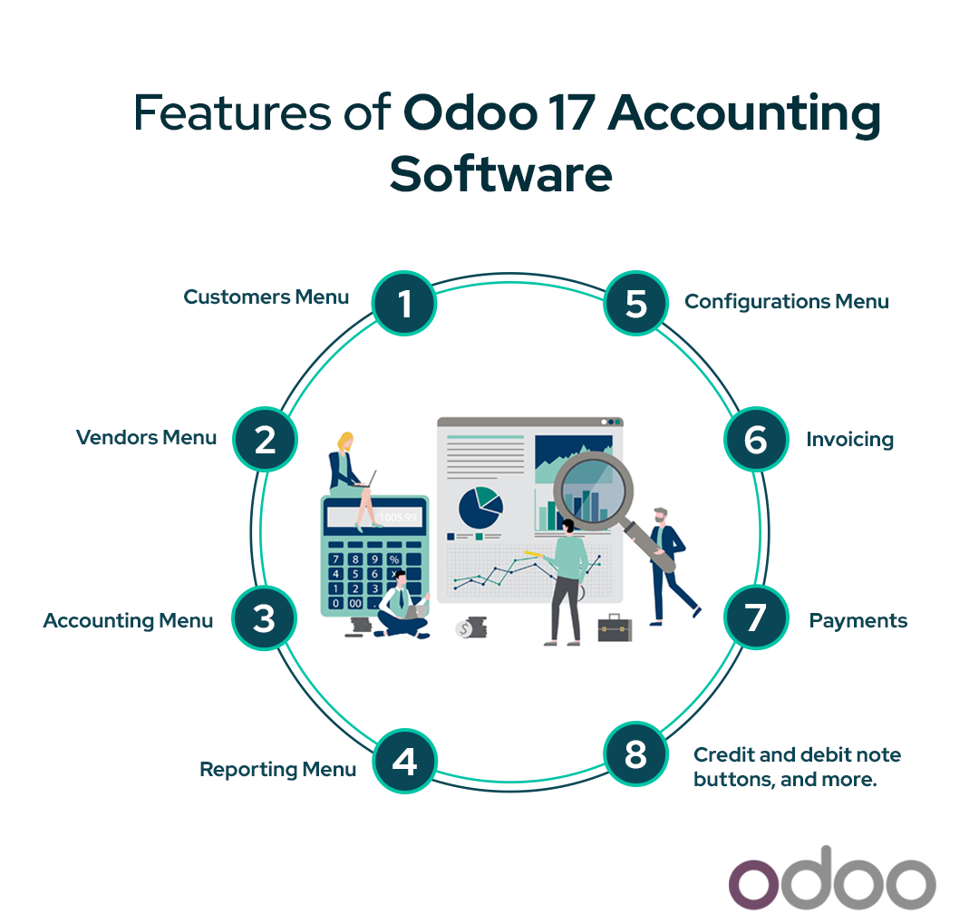
ACCOUNTING
& INVOICING.
08
REPORTING
& ANALYTICS.
Accounting and Invoicing
Automatic syncing of sales data with Odoo’s accounting module.
Real-time tracking of revenues, taxes, and expenses.
Helps in creating invoices and tracking payments from both POS and e-commerce sales.
Simplifies financial reconciliation by aligning sales with banking and accounting data.
Reporting and Analytics
Generates detailed reports on sales, inventory, customer behavior, and employee performance.
Customizable dashboards to provide key performance indicators (KPIs).
Analytics for inventory turnover, sales trends, and customer demographics, helping businesses make data-driven decisions.

Slide 10
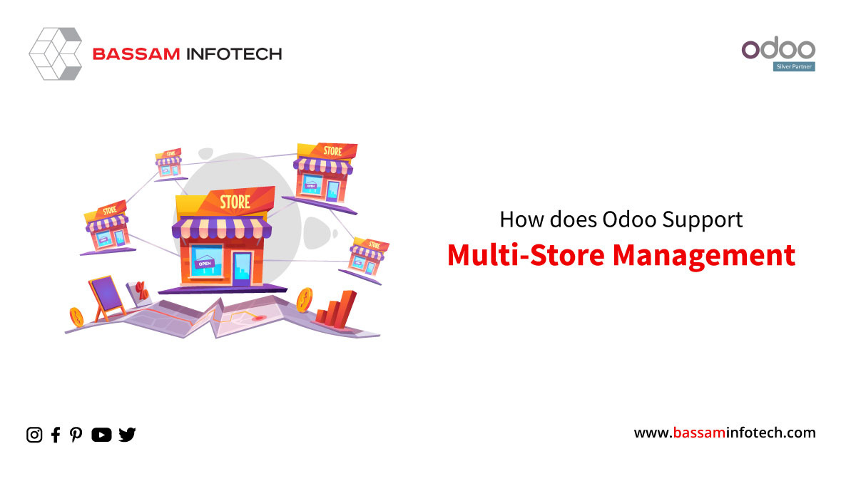
MULTI-STORE
MANAGEMENT
09
Odoo’s platform allows for centralized management of multiple retail locations from one system.
Facilitates consistent pricing, inventory visibility, and reporting across stores.
Useful for businesses with franchise models or chains looking to maintain uniformity across outlets.
E-COMMERCE
INTEGRATION
The platform seamlessly integrates with Odoo’s e-commerce module, allowing retailers to manage online and offline sales from one interface.
Provides a unified inventory system for online and physical stores.
Helps with order tracking, delivery management, and returns processing for online sales.

Slide 11
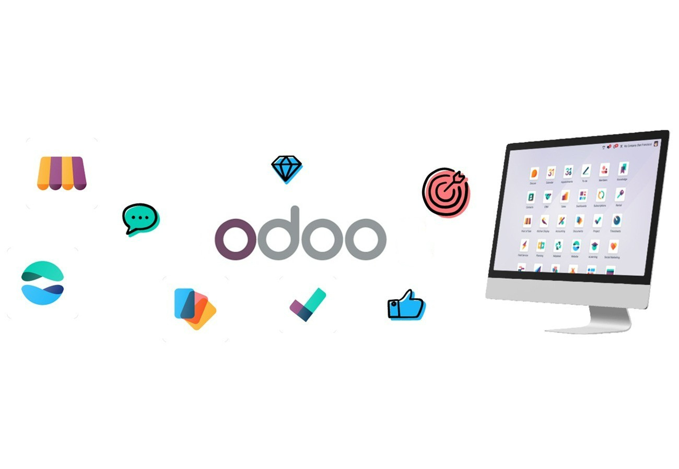
10
CONCLUSION
the Odoo Retail Management System is a comprehensive and flexible solution designed to meet the diverse needs of modern retail businesses. Its seamless integration of core functions like point of sale, inventory management, customer relationship management, e-commerce, and accounting makes it an all-in-one platform that streamlines operations and enhances efficiency. The system’s scalability and customization options make it suitable for businesses of any size, from small retailers to large multi-store chains. By offering real-time data, omnichannel capabilities, and advanced reporting, Odoo empowers retailers to make informed decisions, optimize inventory, improve customer service, and drive profitability. Its modular approach ensures cost-effectiveness, allowing businesses to start small and expand as needed, making Odoo an ideal choice for growing retail enterprises.

Slide 12
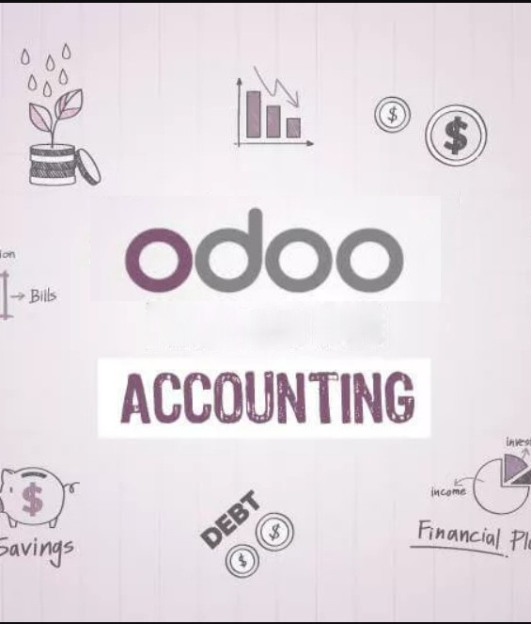
11
Accounating
Module

Slide 13
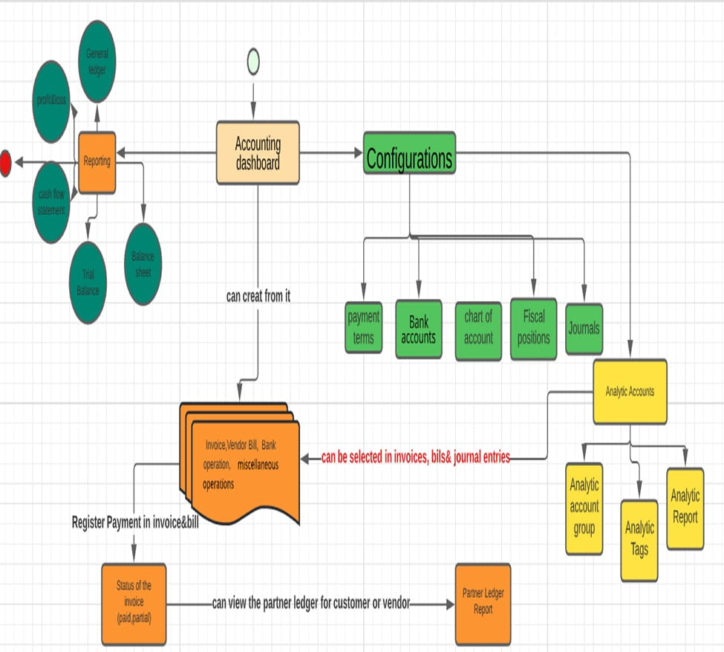
12

Slide 14
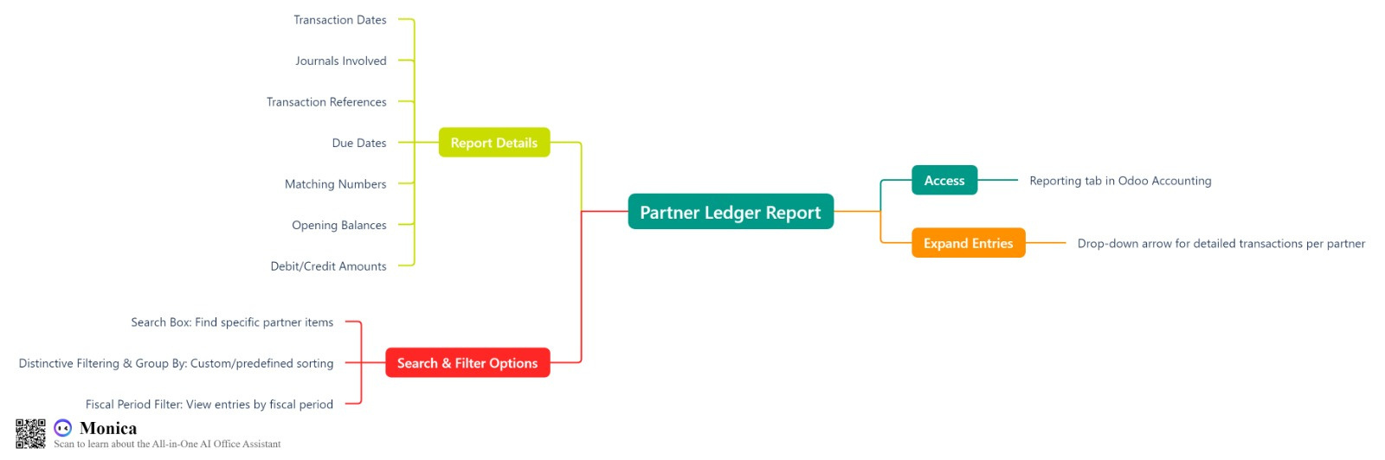
13

Slide 15
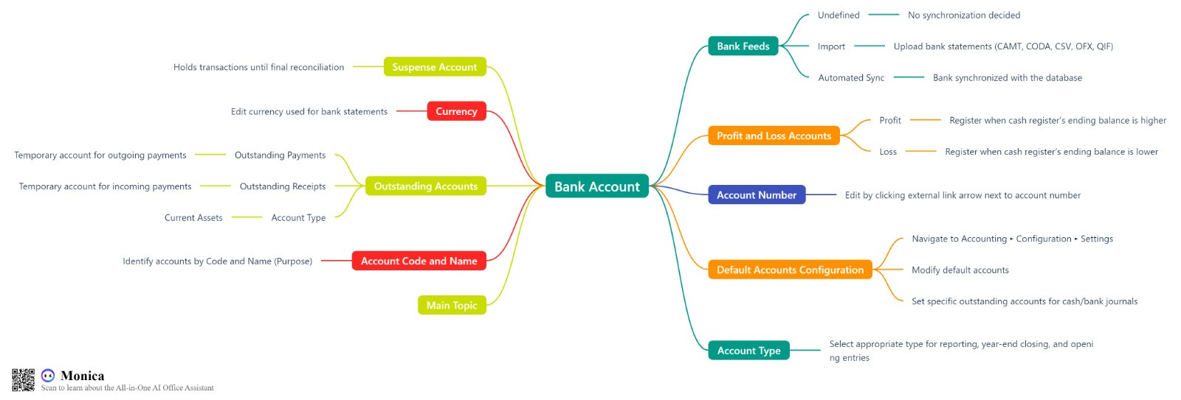
14

Slide 16
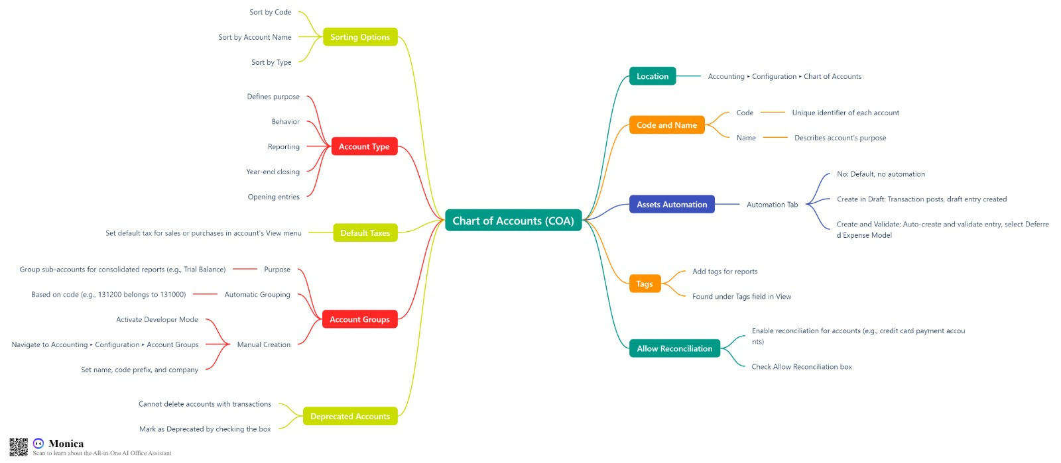
15

Slide 17
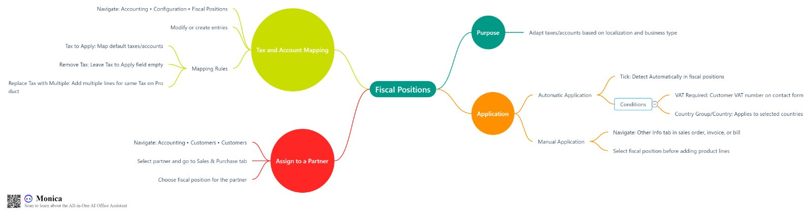
16

Slide 18
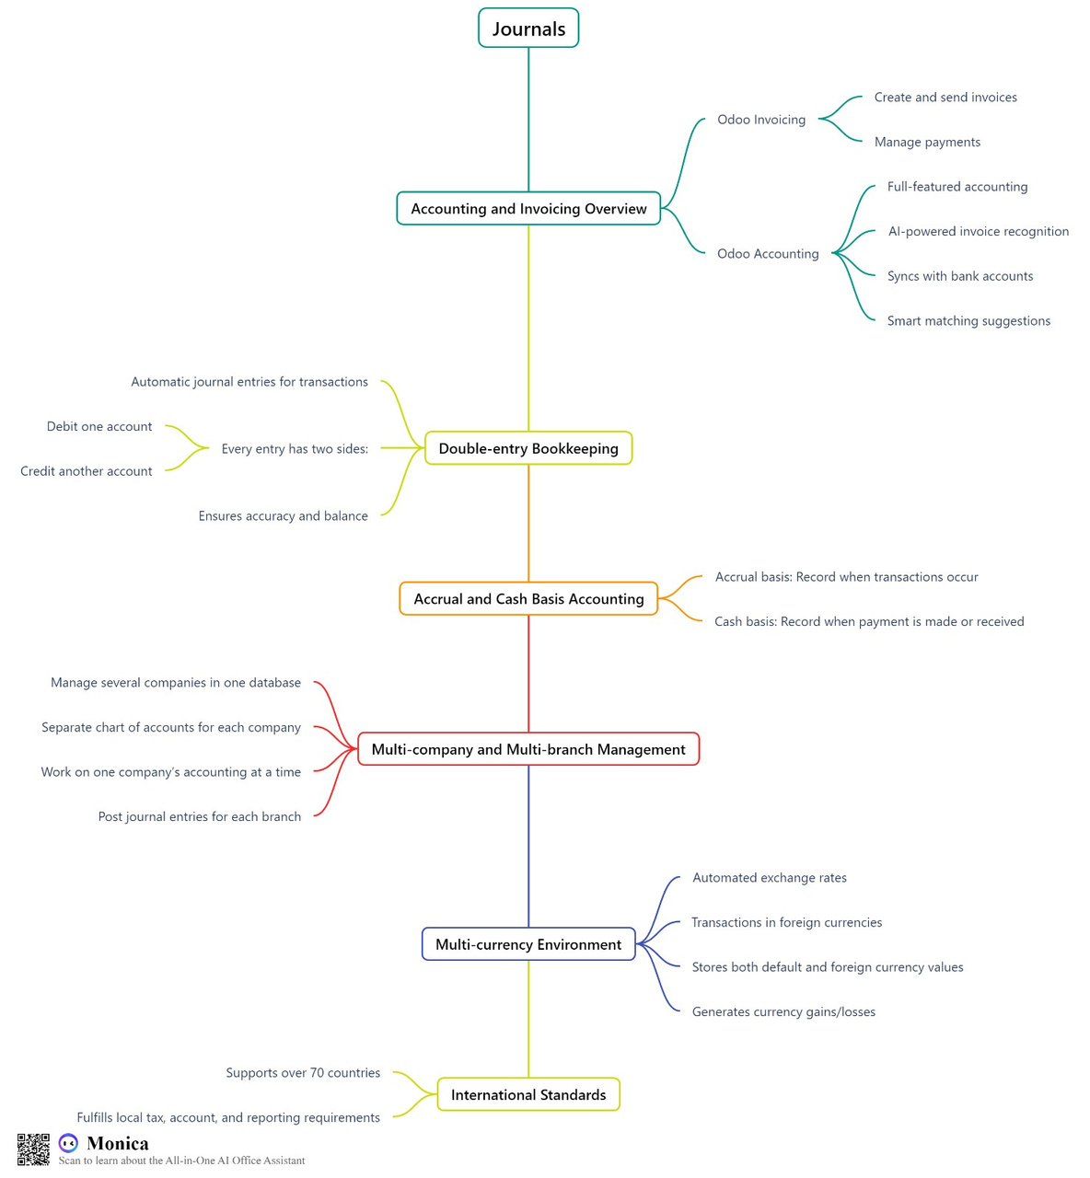
17

Slide 19
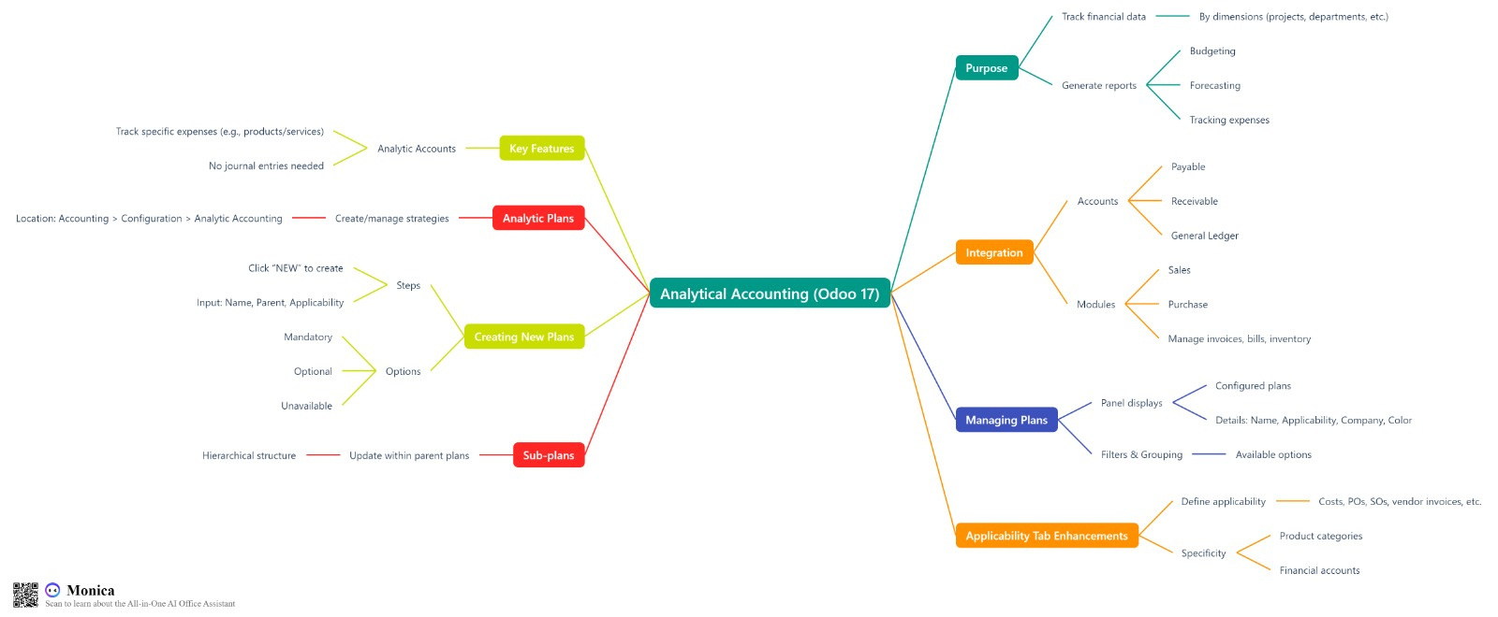
18

Slide 20
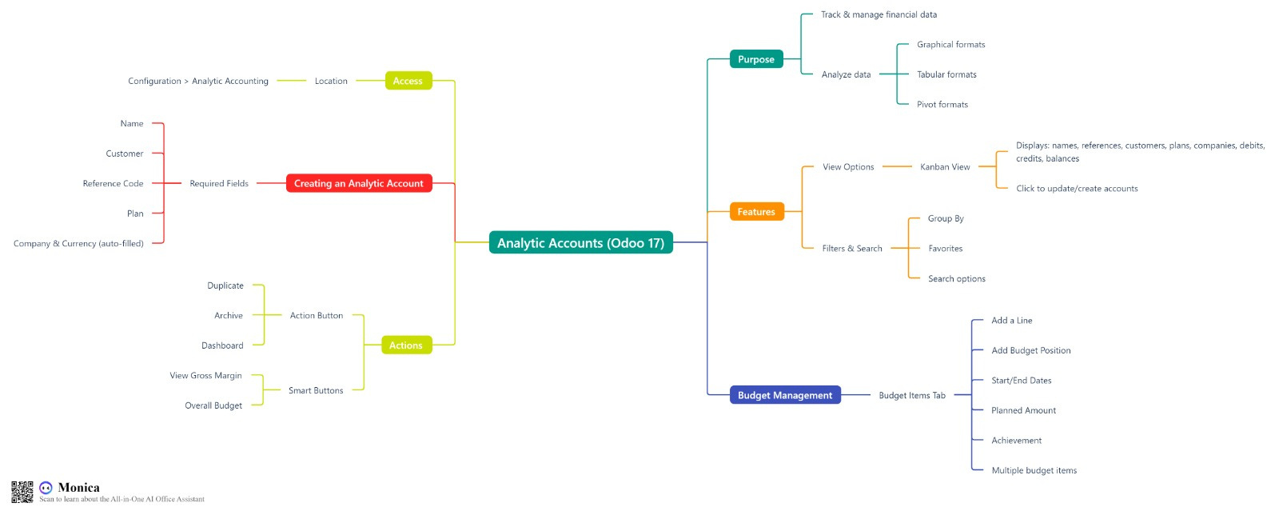
19

Slide 21
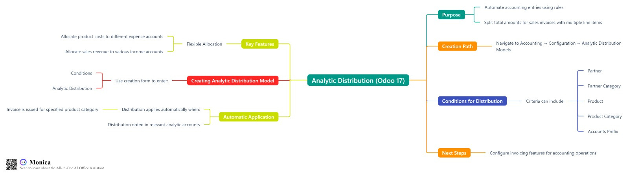
20

Slide 22
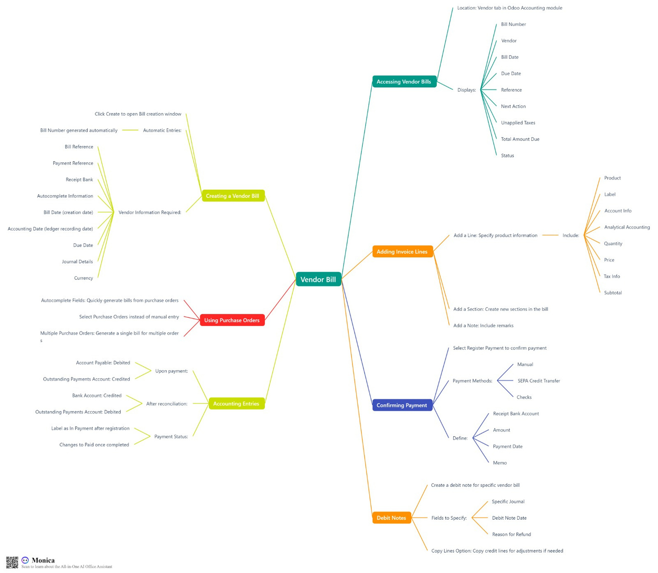
21

Slide 23
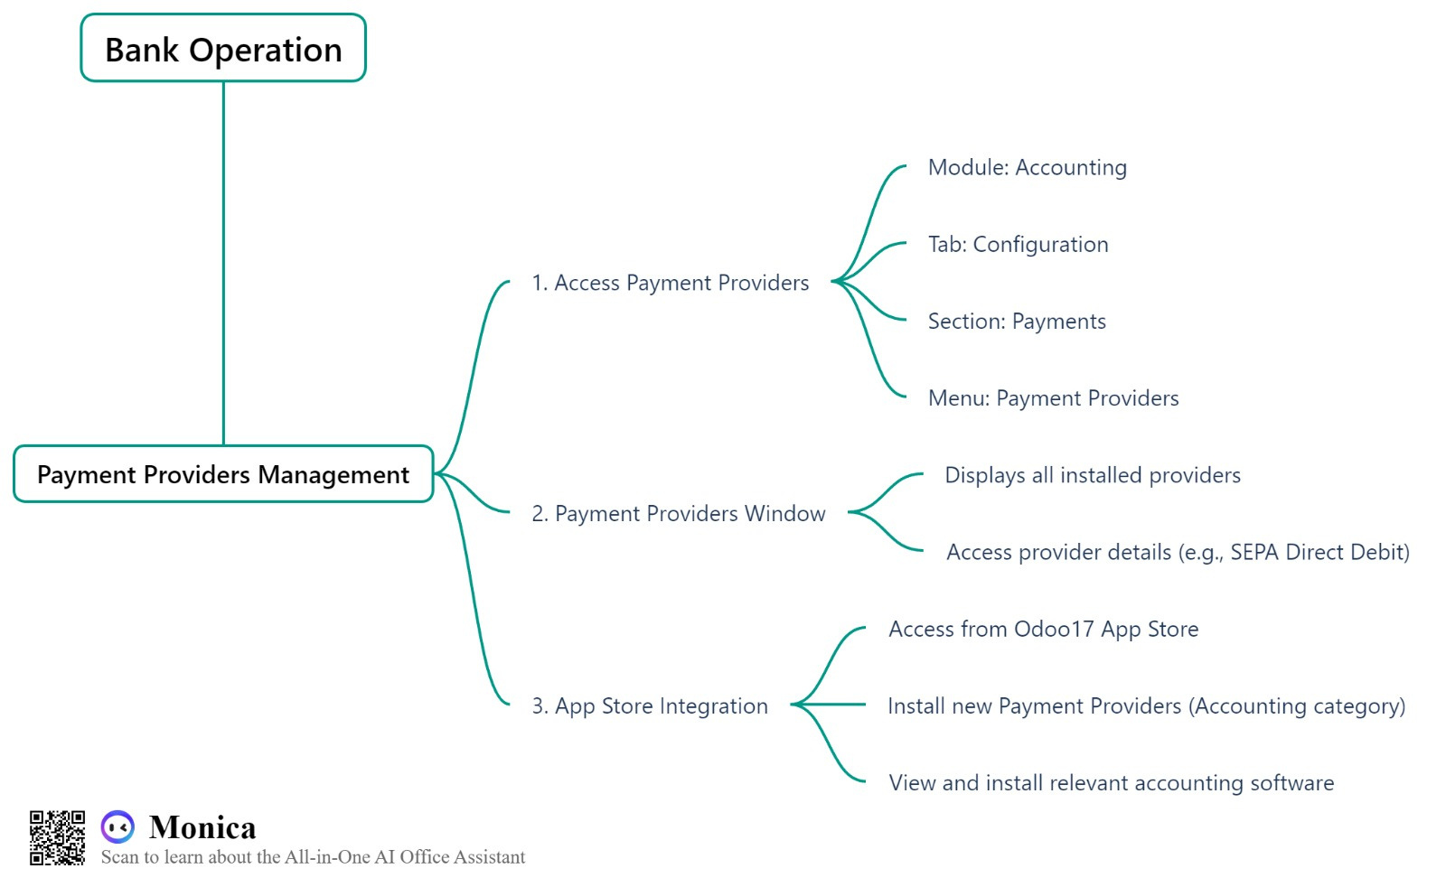
22

Slide 24
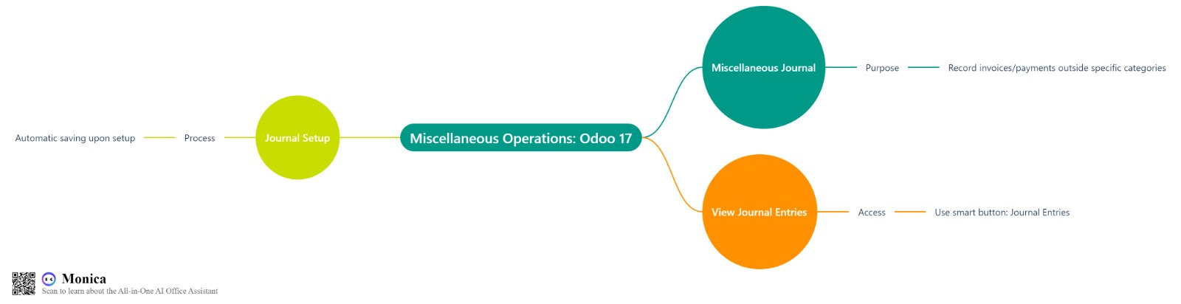
23

Slide 25
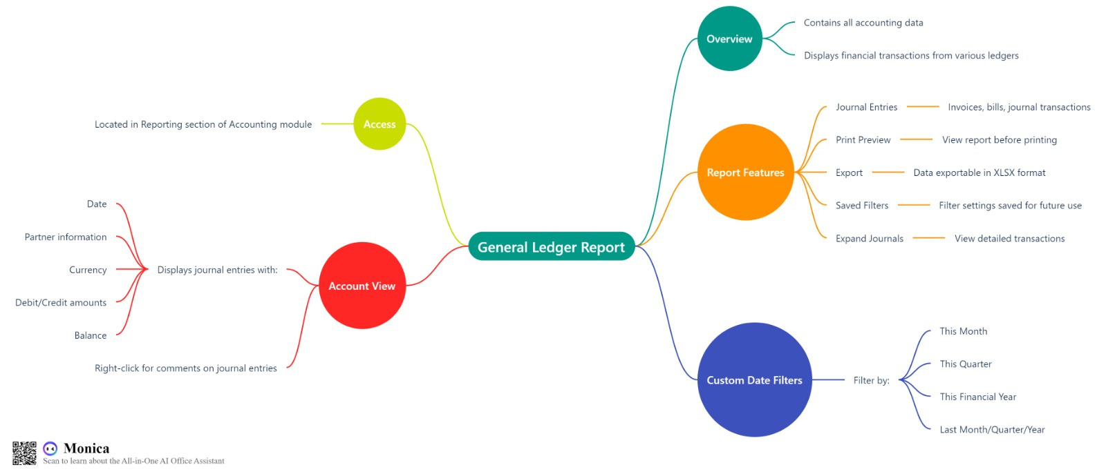
24

Slide 26
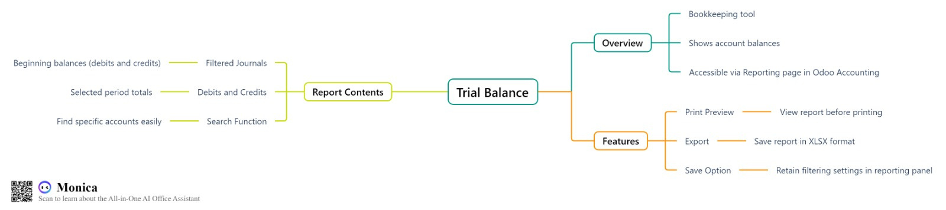
25

Slide 27
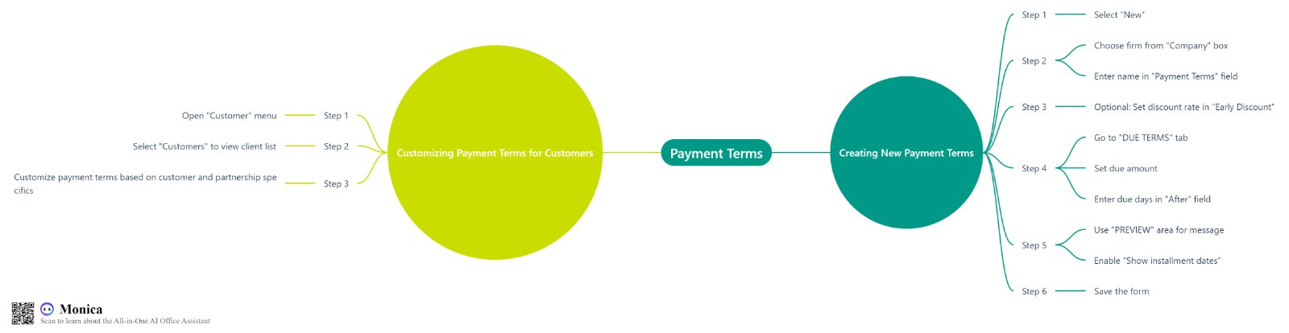
26

Slide 28
27

Slide 29
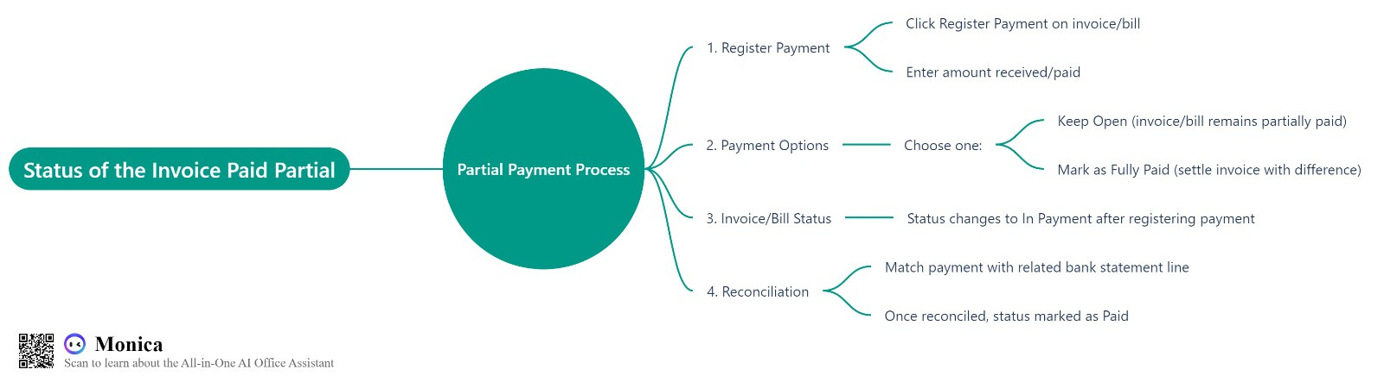
28

Slide 30
29

Slide 31
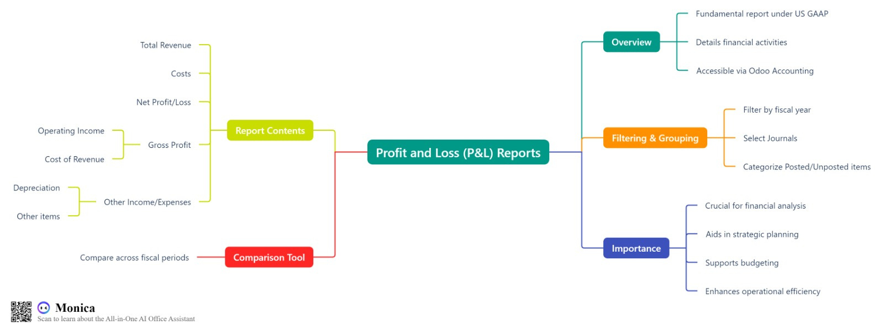
30

Slide 32
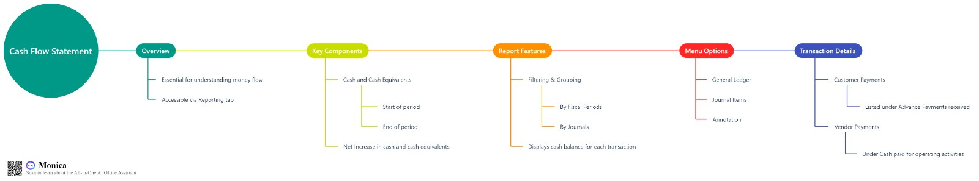
31

Slide 33

32
THANK YOU
General Auditor:Diaa Ezzat Hmadan
Abdullah Muhammed Abdul Hamid
Shady Ahmed Muhammad
Safia Yusuf Abdelghany
Nada Muhammad Ahmed
Wafaa Atef Ahmed
Abdul Rahman Al- Sayed Ahmed

